Slide 1

Introduction to Microsoft Excel
Microsoft Excel is a powerful spreadsheet program that allows users to organize, format, and analyze data. It provides a range of functionalities, including basic arithmetic operations, statistical analysis, and chart creation. Excel is widely used in various industries for data management and reporting.

Slide 2
Basic Functions and Formulas
Sum and Average
If Statements
VLOOKUP and HLOOKUP
Excel enables users to easily calculate the sum and average of a range of numbers, providing basic but powerful arithmetic functions.
The if statements in Excel allow for conditional operations, making it possible to perform different calculations based on specified conditions.
These functions are used to search for a value in a table and return a corresponding result based on the lookup value.

Slide 3
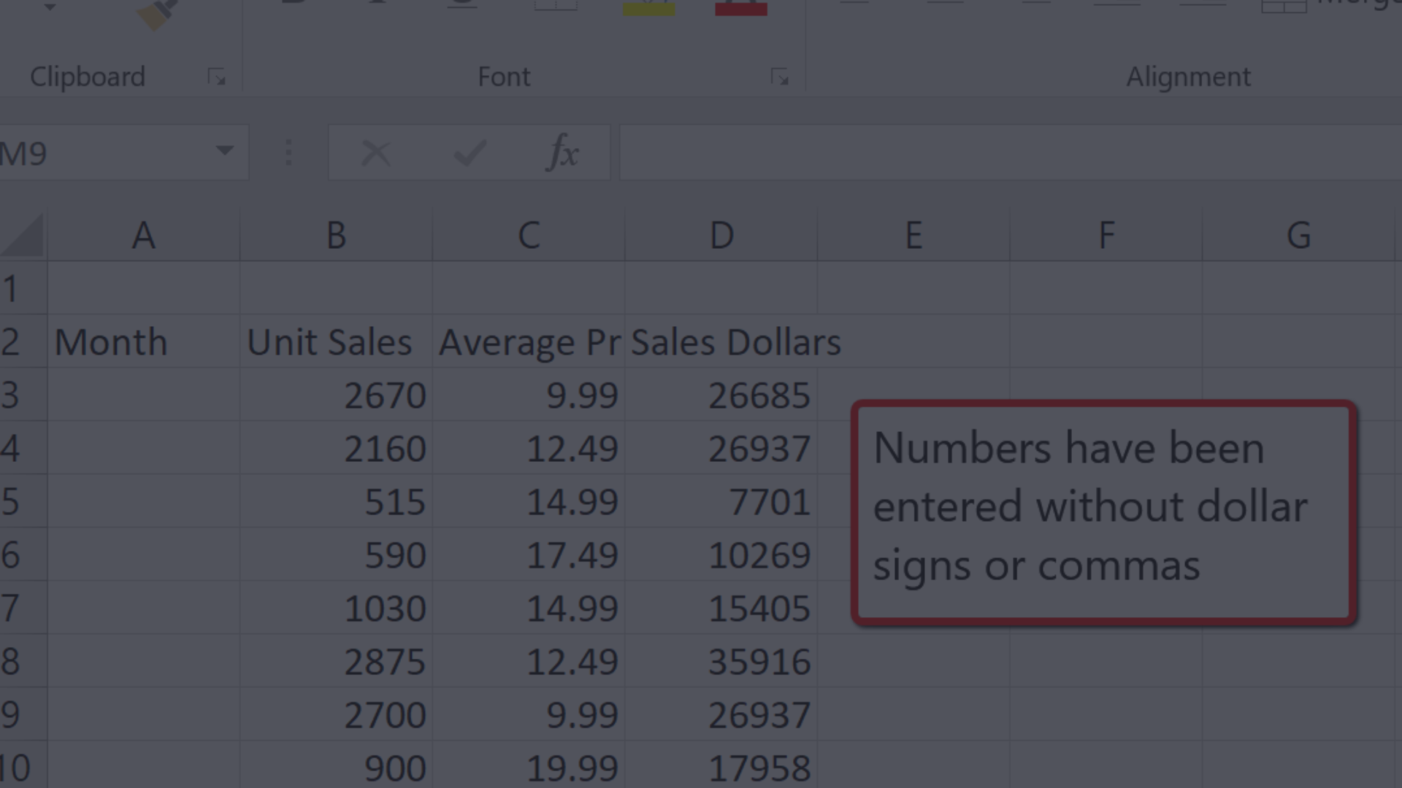
Data Entry and Manipulation
1
Data Input
Efficiently enter and manage large amounts of data using Excel's data entry features.
2
Data Validation
Ensure accurate data entry by setting validation rules for cells, reducing errors and maintaining data integrity.
3
Data Cleaning
Use data manipulation tools to clean, organize, and transform datasets for analysis and reporting.

Slide 4
Formatting and Customization
Cell Formatting
Conditional Formatting
Custom Views
Customize cell formats including font, color, alignment, and borders to enhance the visual appeal of spreadsheets.
Create custom views to display different combinations of worksheet data and settings for various purposes.
Apply conditional formatting rules to highlight and analyze data based on specific criteria, enabling quick insights.

Slide 5
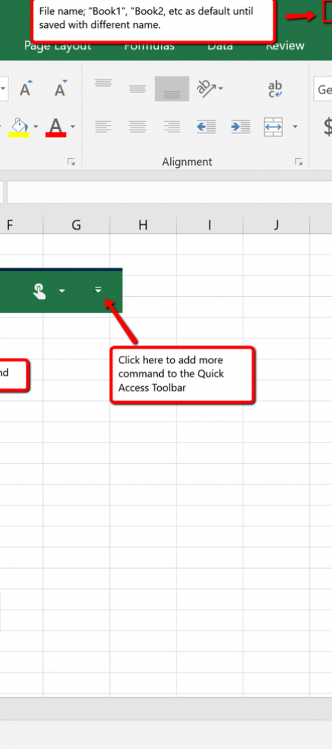
Working with Worksheets and Workbooks
1
Sheet Management
2
Workbook Interaction
Easily add, delete, and organize worksheets within a workbook to efficiently manage data and analysis.
Utilize various workbook features such as linking, grouping, and referencing data across multiple sheets.
3
Template Creation
Create and customize templates for worksheets and workbooks to maintain consistent formatting and structure.

Slide 6
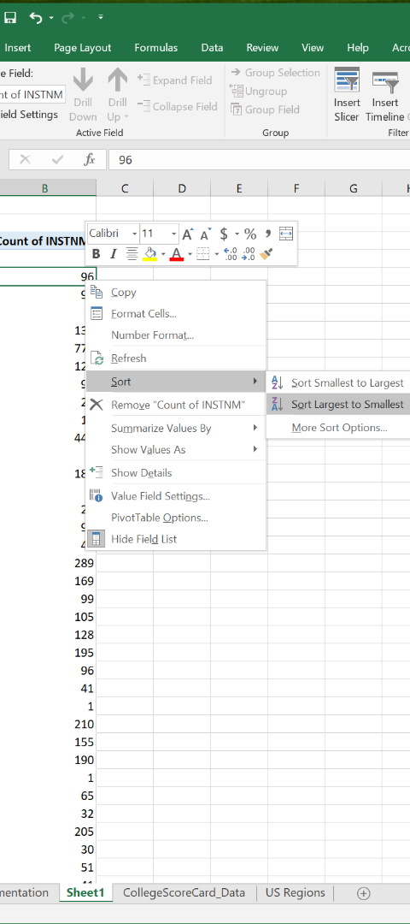



Sorting and Filtering Data
Data Sorting
Sort data in Excel alphabetically, numerically, or based on specified criteria to organize and analyze content.
Data Filtering
Apply filters to quickly view specific data subsets, allowing for focused analysis and reporting.
Advanced Filtering
Utilize advanced filter options to extract and display specific data patterns and trends from large datasets.

Slide 7
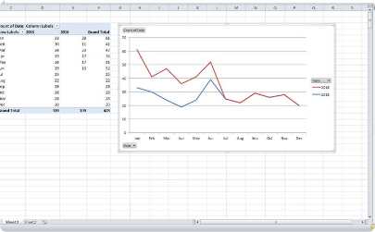
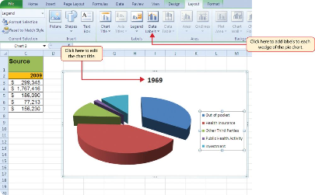
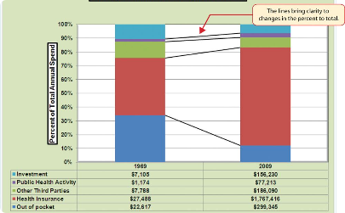
Creating Charts and Graphs
Line Charts
Pie Charts
Bar Charts
Visualize trends and patterns over time using line charts, suitable for showing continuous data series.
Display data proportions using pie charts, providing a simple way to understand relative contributions of different categories.
Compare categories of data using bar charts, ideal for showing comparisons between different items.

Slide 8
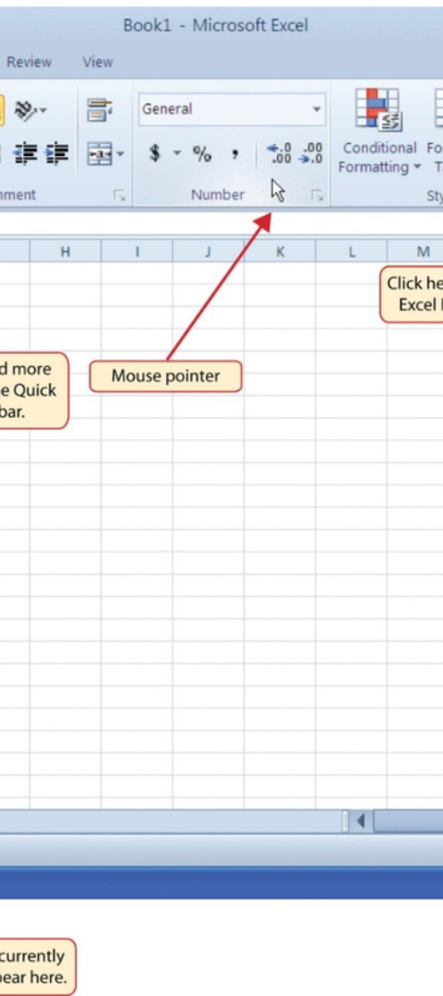
Advanced Functions and Formulas
Array Formulas
Lookup and Reference Functions
Use array formulas to perform multiple calculations and return multiple results in Excel efficiently.
Utilize advanced lookup and reference functions for sophisticated data retrieval and analysis.
Statistical Functions
Apply statistical functions in Excel to analyze and interpret datasets, providing valuable insights for decision-making.

Slide 9
Data Analysis and Visualization
1
Data Analysis Tools
Explore Excel's data analysis tools, including pivot tables, scenarios, and goal seek for in-depth analysis and visualization.
Visual Data Representation
2
Create visually compelling charts, graphs, and dashboards to present data and gain meaningful insights at a glance.
3
Trend Analysis
Utilize Excel's trend analysis tools to identify patterns and forecast future trends based on historical data.

Slide 10
THANK YOU

